Slide 1
OpenAI in Vision
Presenter by : Mohammed Zeeshan Mentor: Vivek Singh

Slide 2
Introduction to AI Vision
GPT-4 with Vision, sometimes referred to as GPT-4V or gpt-4-vision-preview in
the API, allows the model to take in images and answer questions about them.
Historically, language model systems have been limited by taking in a single input
modality, text. For many use cases, this constrained the areas where models like GPT-4
could be used.

Slide 3
AI vision
Uses of AI vision

Slide 4
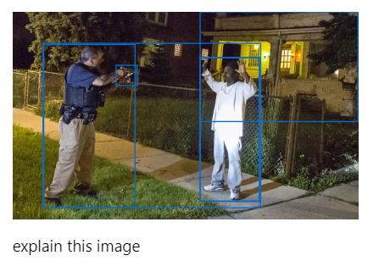
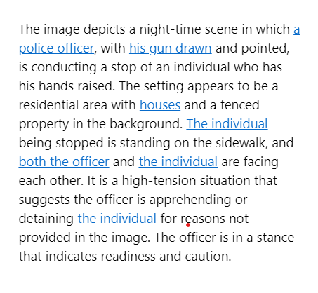
Azure AI Vision
A unified service offering innovative computer vision capabilities.
Analyzes images, Videos, reads text, and detects faces.
Uses prebuilt image tagging, text extraction with optical character recognition (OCR), and responsible facial recognition.

Slide 5
Uses of OpenAI Vision
Image Understanding: It can analyze images and answer questions about them. For example, you can ask it what color a car is or what some ideas for dinner might be based on what is in your fridge.
Data Extraction: It can extract a wealth of details about an image in text form. For instance, given an image of an invoice, it can extract details like the invoice number, date, billing information, and line items.
Video Understanding: It can also be used to understand videos.
Text-to-Image Association: It can associate text inputs with images, enhancing the capabilities of language models.
Unstructured Data Processing: It can process unstructured text into orderly data models.

Slide 6
Thank You…..

